Slide 1

Presentation by
Faizan Asad P17-6056
Ammad Aamir P17-6119
Basharat Hussain P17-6102

Slide 2



• Instagram is an online mobile photo-sharing, videosharing and social networking service that enables its users to take pictures and videos and share them on a variety of social media networking platforms, such as Facebook, Twitter.
• Instagram photos confine to a square shape, similar to Kodak Instamatic and Polaroid images.
• The name “Instagram” is a portmanteau of “instant camera” and “telegram”.

Slide 3
Instagram was founded in 2010 by Stanford graduates Kevin Systorm and Mike Krieger. Initially, Systorm and Kreiger created an HTML5 check-in project called Burbn which was then redeveloped to cater only photo-sharing uploads • On October 6, 2010, Instagram was added to the Apple App Store, generating 10,000 registered users within the first few hours of it’s app life. • In April 2012, Instagram was added to Android phones and was downloaded more than one million times in less than one day. • In late 2012, Instagram was purchased by Facebook for $1 billion
History of Instagram

Slide 4


Slide 5

Kevin Systrome
Mike Krieger
Co-Founders

Slide 6

Mission
We're building Instagram to allow you to experience moments in your friends' lives through pictures as they happen.

Slide 7
Vision
We created Instagram to solve three simple problems:
Mobile photos always come out looking mediocre. Our awesome looking filters transform your photos into professional-looking snapshots.
Sharing on multiple platforms is a pain - we help you take a picture once, then share it (instantly) on multiple services.
Most uploading experiences are clumsy and take forever - we've optimized the experience to be fast and efficient.

Slide 8




Instagram is owned by Facebook.

Slide 9
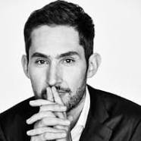

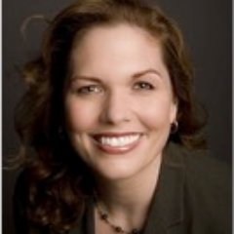
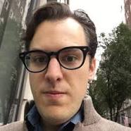
Kevin Systrome(Co-Founder & CEO)
Kristina Schake(Communication)
Marine Livine(COO)
Mike Krieger(CTO &Co-Founder)

Slide 10
Marine Livine (COO)
Tracy Yaverbaun (EMEA Brand Development)
Garrick Tiplady (Canada)

Slide 11
Mike Krieger(CTO & Co-Founder)
Shayene Sweeny (Engineering Manager)
Lee Bearman (Engineering Manager)
Kristina Schake(Communication)
Aanna White (Consumer Communications)

Slide 12

Any Questions?
@Bashar_ul_asad
@ammad_amir

